Slide 1



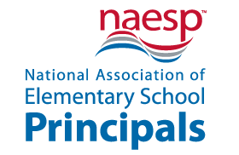


Tri-Association Membership
EBSCO Deluxe Database
School Membership Benefits
The Tri-Association is a non-profit organization, comprised of private, accredited, independent schools, offering an American-style education, and residing in three geographic regions (Central America, Mexico, Colombia, Caribbean). Membership includes high access to many events throughout the year.
EBSCO is the leading provider of research databases, e-journals, magazine subscriptions, eBooks and discovery service for academic libraries of all kinds. EBSCO subscription includes full access to the basic membership and package for the entire school community.
NAESP Membership
The Association of American Schools of Central America (AASCA) was formed to support and encourage academic, artistic, athletic and cultural interaction between international schools that offer a US type education in Central America.
www.aascaonline.net
In addition to AASCA events, activities and resources, AASCA membership provides schools with membership in the Tri-Association, EBSCO, NAESP, NAIS and the opportunity to support the Children of Haiti project.
NAESP is a professional organization serving elementary and middle-level principals who represent 35 million children in pre-K through grade 8. NAESP provides one membership for each ELEM principal at each school, A/OS schools receive an additional membership.
NAIS Membership
The National Association of Independent Schools (NAIS) is a nonprofit membership association that provides services to more than 1,900 schools and associations of schools in the US and abroad. NAIS offers one membership for each Head of School.
AASCA COHOP donation
Annually, AASCA Schools donate $2500 dollars to help Haitian students to stay in school.
Website: https://www.facebook.com/Children-of-Haiti-Project-1820404171515664/

Slide 2
AASCA
School Membership Benefits
Tri-Association Membership
Schools that belong to one of the three sub-regional organizations; ACCAS, ASOMEX AND AACSA are considered regular members of the Tri-Association and have full membership benefits.
Benefits for Regular Member Schools include:
Non-limited participation in the Annual Educators' Conference and reduced conference and institutes fees.
Eligibility for participation in annual awards programs (Paul G. Orr, Community Service, Margaret E. Sanders, TieCare Global Leadership Award).
Preferential access to special institutes and other staff development programs, some leading to a graduate degree or special endorsement.
Access to EBSCO deluxe data base.
Access to ISC (International Data Base) Services
Membership to NAIS and NAESP.
Access to the Association’s Newsletter (3 times per year), and other electronic information regarding the Association’s projects and activities.
Eligible for funding of a school based staff development conference through an application process.
Access to communication regarding special programs and other informational topics of relevance to schools.
Access to educational research bulletins, executive summaries and information.
Eligibility to be represented on the Staff Development Advisory Council (SDAC).
Participation in the Annual Salary & Benefits Survey
Check out Tri website for more information. Tri-Association Executive Director: Dr. Michael D. Adams, mwadams@tri-association.org
The Tri-Association is a non-profit organization, comprised of private, accredited, independent schools, offering an American-style education, and residing in three geographic regions (Central America, Mexico, Colombia, Caribbean). Membership includes high access to many events throughout the year. Check out Tri website for more information. Tri-Association Executive Director: Dr. Michael D. Adams, mwadams@tri-association.org

Slide 3
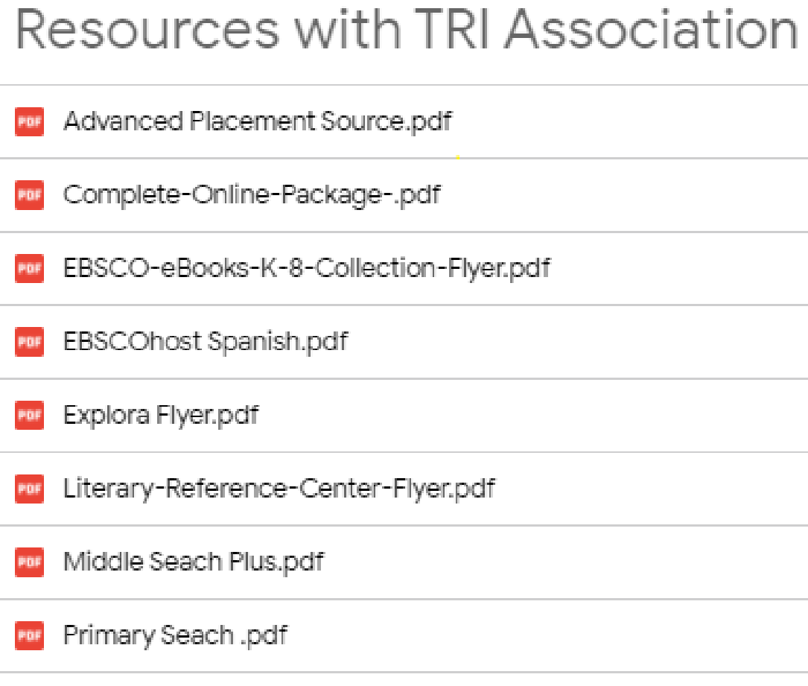
AASCA
School Membership Benefits
To access EBSCO resources use the following link:
  https://search.ebscohost.com/login.aspx?authtype=ip,uid&custid=ns004835&groupid=main
Username: You need your school username
Password: You need your school password
You can contact:
Contact info: Luis Lagares –Account Executive for Guatemala, Honduras & Nicaragua: llagares@ebsco.com
The above link can be posted in the Library website and provide easy access to EBSCO resources.
Faculty members hace access to online training for Explora:
  Explora para Bibliotecas Publicas, de Escuela Primaria, Secundaria
Next Training:
December 14, 2021
10:00 .m. (Costa Rica time)
EBSCO Deluxe Database
EBSCO is the leading provider of research databases, e-journals, magazine subscriptions, eBooks and discovery service for academic libraries of all kinds.
EBSCO contact information:

Slide 4
Ultra Online Package (for high school students): Consisting of six databases, the Ultra Online Package™ offers a comprehensive collection of full-text reference resources available for secondary schools. This full-text package contains databases designed not only for students, but also for educators. This package provides access to the following:
1. Professional Development Collection: This is the most comprehensive and most valuable collection of full-text education journals in the world. Professional Development Collection™ includes full text for the highest quality education journals.
2. ERIC®ERIC®, the Education Resource Information Center, provides access to education literature and resources. The database provides access to information from journals included in the Current Index of Journals in Education and Resources in Education Index.
3. MAS Ultra – School Edition: This comprehensive database, designed specifically for high school libraries, contains full text from the most popular high school magazines. Full text is also available for biographies, primary source documents and reference books.
4. Newspaper Source: Newspaper Source™ provides cover-to-cover full text for national (U.S.) and international newspapers
5. Health Source: Consumer Edition: Health Source®: Consumer Edition is a rich collection of consumer health information. This resource provides access to full-text consumer health magazines as well as full text for current health-related pamphlets and health reference books.
6. TOPICsearch: This current events database allows researchers to explore social, political & economic issues, scientific discoveries and other popular topics discussed in today's classrooms including controversial opinions and viewpoints. It contains full text from nearly 260 diverse sources.
Middle Search Plus (for middle school students):Middle Search® Plus contains full text from the most popular middle school magazines. Full text is also available for thousands of biographies and historical essays as well as primary source documents, reference books and thousands of relevant photos, maps and flags.
Primary Search (for primary grades):Primary Search®, designed specifically for elementary school libraries, contains full text from the most popular elementary school magazines. Primary Search includes the Encyclopedia of Animals™, and features Funk & Wagnalls New World Encyclopedia, providing students with easy-to-read encyclopedic entries written specifically for kids. The database also provides thousands of relevant photos, maps, and flags.
Literary Reference Center: Literary Reference Center™ is a comprehensive, full-text database that provides users with a broad spectrum of information on thousands of authors and their works across literary disciplines and timeframes. Literary Reference Center contains full text for plot summaries, synopses and work overviews, articles/essays of literary criticism, author biographies, literary journals, book reviews, classic and contemporary poems, classic and contemporary short stories, author interviews, classic texts, and much more.
Advanced Placement Source: Designed to meet the extensive needs of high school students enrolled in various AP and IB courses, Advanced Placement Source™ offers a world of knowledge for students who seek to achieve academic excellence in humanities, sciences, history, geography, mathematics, and more. This database contains full-text academic journals and magazines, as well as relevant photos, maps and flags.

Slide 5
Award-Winning Publications
Principal magazine—5 times a year online, for the information and insight you need to be a better principal. Includes exclusive access to a searchable archive.
Communicator—Monthly e-newsletter that highlights education-related news, research, and trends. “Report to Parents”— Delivered with Communicator, a bulletin you can reproduce and circulate to parents; features practical information on a range of family-friendly topics. In Spanish and English.
“Before the Bell”—An email brief on the latest U.S. education news delivered 2 times a week.
Professional Standards: Leading Learning Communities—Research-based, gold standard for what elementary principals should know and know how to do; sets priorities and provides specific tools and resources to help principals meet standards of highly effective leadership. Also: Leading Early-Childhood Learning Communities and Leading After-School Learning Communities.
Professional Networking: Global network—20,000 of your peers who share the complexities, rewards, and challenges of being a principal. Connect on the NAESP Facebook page, LinkedIn group, Twitter feed, the Principal’s Office blog, and our new members-only virtual community, Principal 2 Principal.
Best Practices: Online Samples—Project ideas, programs, and techniques principals have implemented in their own schools; excellent starting point for principals who want to improve their schools.
  Best Practices for Better Schools—white papers and much more available online.
  On-Demand Insight
  NAESP Radio—Online interviews with education experts. Listen at www.naesp.org
  Discounts to Members
  Professional Development
  Annual Conference—The National Event of the Year, the conference features internationally acclaimed speakers, panel discussions, interactive breakouts, and more.
  Professional Resources
  Books—Visit our bookstore at www.naesp.org for the latest books for principals.
  Enhanced Purchasing Power
  Principals’ Buyers Guide—Online guide that directs principals to vendors that offer products and services every school’s needs.
AASCA
School Membership Benefits
NAESP
NAESP is a professional organization serving elementary and middle-level principals who represent 35 million children in pre-K through grade 8. NAESP provides one membership for each ELEM principal at each school, A/OS schools receive an additional membership.
NAESP members worldwide have access to high-quality, targeted benefits and services—many at no or low cost—that deliver value far higher than the annual cost of membership. The TRI- Association membership, available to principals working outside the U.S. and its territories,
Contact Info: Jackie McGrail, Associate Executive Director, Membership, Development, and Affiliated Services, NAESP, jmcgrail@naesp.org

Slide 6
AASCA
School Membership Benefits
NAIS will deliver the following services and products to THE TRI-ASSOCIATION:
1. NAIS Career Center Access
All TRI-ASSN members will be able to post jobs and search resumes in the online NAIS Career Center database. NAIS will work with TRI-ASSN to create user accounts for all TRI-ASSN members, into the NAIS system to be delivered no later than July 31, 2019.
2. Organizational Membership Discounts
TRI-ASSN schools may purchase conferences, workshops, publications, and magazines from NAIS at member discounts. Both associations will work together to jointly promote programs of special interest to school heads in the United States and Central America, Colombia, Caribbean, and Mexico.
3. TRI-ASSN Members will receive subscriptions to the NAIS Bulletin electronic newsletter.
Contact info: Amelia Kurtz, NAIS Director of Engagement, membership@nais.org or submit a ticket at NAIS help center: https://my.nais.org/s/submit-a-ticket?category=Membership
NAIS
The National Association of Independent Schools (NAIS) is a nonprofit membership association that provides services to more than 1,900 schools and associations of schools in the US and abroad. NAIS offers one membership for each Head of School.
Website: www.nais.org

